Slide 1


E-COMMERCE CHATBOT
USING LSTM
CHANDRASEKARAN P
422521104008
chandrasekaran4096@gmail.com
University college of Engineering Villupuram

Slide 2
OUTLINE
PROBLEM STATEMENT
PROPOSED SYSTEM/SOLUTION
SYSTEM REQUIREMENT
ALGORITHM AND DEPLOYMENT
WHO ARE THE END-USERS?
RESULT
CONCLUSION
REFERENCES

Slide 3
PROBLEM STATEMENT
The problem in eCommerce customer support is high response times and operational inefficiencies. We implemented an automated chatbot using deep learning techniques to provide real-time, consistent, and cost-effective customer support. This solution aims to enhance user experience and streamline the support process.

Slide 4

PROPOSED SYSTEM/SOLUTION
CHATBOT ARCHITECTURE DESIGN:
Design a chatbot architecture using LSTM networks for natural language processing, complemented by text cleaning, tokenization, and intent classification to deliver precise and relevant responses.
DEEP LEARNING MODEL:
Utilizing LSTM networks to process and understand the sequential nature of natural language data effectively. This involves processing textual data and capturing long-term dependencies in sequences, facilitating the model's understanding and classification of user queries.

Slide 5

TEXT PREPROCESSING:
This invo﻿lves removing unnecessary characters, converting text to lowercase, lemmatizing words, and removing stopwords to prepare the text data for model input.
HYPERPARAMETER TUNING:
Utilize Keras Tuner to automate the optimization of model parameters to improve performance and accuracy. This involves systematically exploring the hyperparameter space to find the optimal configuration for the model.
TOKENIZATION AND PADDING:
Implement tokenization and padding techniques to convert text data into numerical sequences and ensure a consistent input length for the model. This involves tokenizing te﻿xtual data to convert words into numerical form and applying padding to ensure a uniform sequence length.

Slide 6



SYSTEM APPROACH
CPU: A multicore processor to handle computational tasks efficiently, supporting the intensive processing demands of deep learning algorithms
RAM: Minimum of 8GB RAM to ensure smooth performance during model training and inference, accommodating the memory requirements of large datasets and complex computations.
HARDWARE
Internet Connection: Stable and high-speed internet connection to facilitate data retrieval, model updates, and seamless interaction with external services and APIs.

Slide 7



SYSTEM APPROACH
Python: Programming language used for developing the chatbot application.
TensorFlow/Keras: Deep learning libraries used for building and training the LSTM model.
NLTK: Natural Language Toolkit used for text preprocessing and tokenization.
SOFTWARE
scikit-learn: Library for various machine learning tasks like data preprocessing and model evaluation.
Jupyter Notebook: Interactive computing environment used for prototyping, data analysis, and model development.
Optional: Django for web-based interface (if applicable)

Slide 8
ALGORITHM AND DEPLOYMENT
1.DATA PREPARATION:
Retrieved the dataset from Kaggle to serve as the basis for training and testing the chatbot model
2. TEXT PREPROCESSING:
Cleaned and organized raw text data usi﻿ng NLTK for text processing.
Removed punctuation and stopwords to ensure clean input.
Lemmatized words to reduce them to their base form
Tokenized text to convert sentences into a list of words for analysis

Slide 9
ALGORITHM AND DEPLOYMENT
3.DEEP LEARNING MODEL: NETWORKS
Implemented LSTM networks to process and understand natural language data
Employed a dense layer with 208 units followed by a softmax output layer
Utilized the Adam optimizer with a learning rate set to 0.01
Configured the model with two LSTM layers, each having 110 units
4.HYPERPARAMETER TUNING: KERAS TUNER
Utiliz﻿ed Keras Tuner to automate the optimization of model parameters
Tuned the number of units in LSTM layers ranging from 50 to 150.
Explored the number of dense layers in the model from 1 to 20.

Slide 10
ALGORITHM AND DEPLOYMENT
Adjusted learning rates between 0.01, 0.001, and 0.0001 for optimal performance.
5. TOKENIZATION AND PADDING:
Tokenized the text data using Keras Tokenizer to convert words into numerical sequences.
Applied padding to ensure a uniform sequence length of 200 for model input.
Set the vocabulary size to 2000 to capture the most frequent words in the dataset.
Used an out-of-vocabulary token (OOV) to handle words not in the vocabulary during tokenization.

Slide 11

DEPLOYMENT
The chatbot code is hosted on GitHub by implementing the main code directly on a Jupyter Notebook. This approach allows for easy viewing and execution of the code.
1. Jupyter Notebook:
The chatbot is presented as a user-friendly web-based interface using the Django framework and hosted on GitHub. This method offers a seamless user experience and makes the chatbot accessible via a web browser.
2. Django Web Application:

Slide 12
WHO ARE THE END USERS?
Online Shoppers: Individuals looking for product information, recommendations, or assistance with their shopping experience
Customer Support Teams: Staff members responsible for handling customer queries and providing timely and accurate responses.
Website Visitors: Potential customers exploring the eCommerce website whomay have questions or require assistance.
Technical Support: IT professionals or developers involved in maintaining and updating the chatbot's functionality and performance

Slide 13
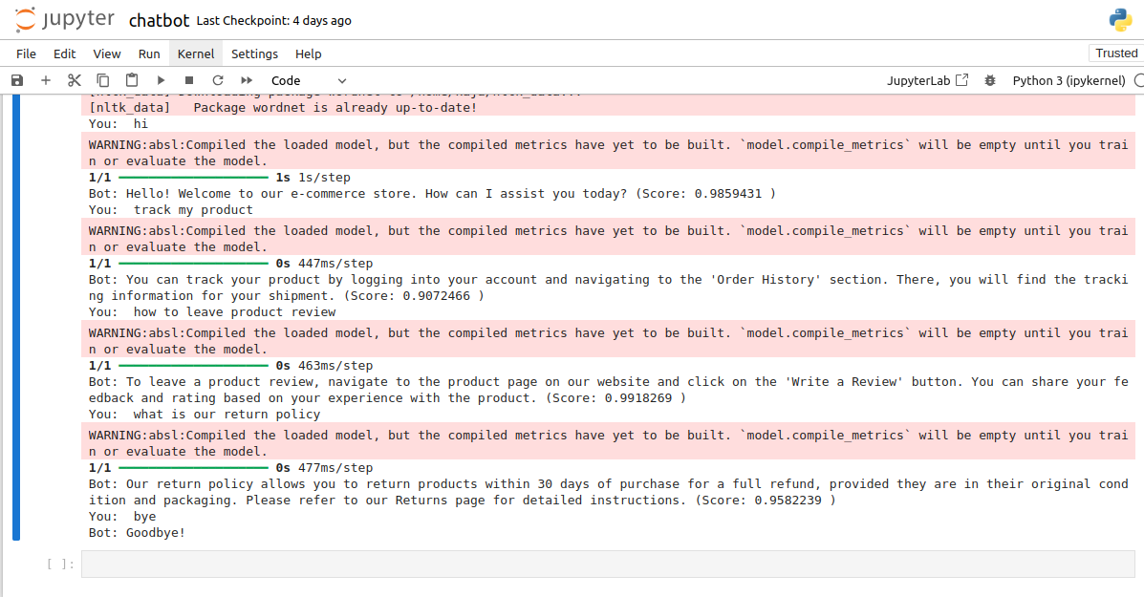

RESULT
Executed on jupyter

Slide 14
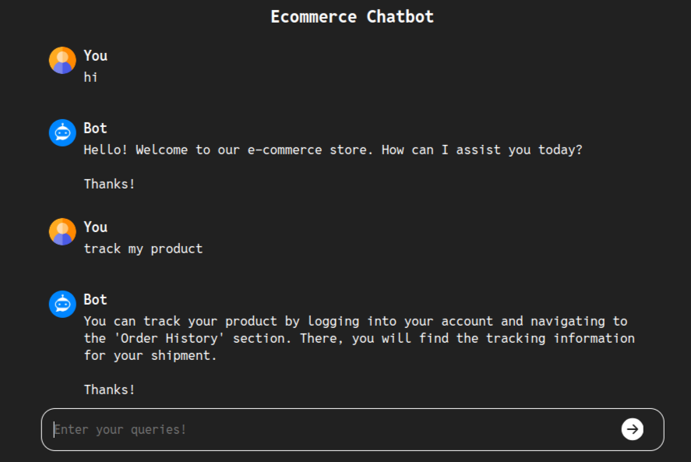
RESULT
Implemented on Django

Slide 15
CONCLUSION
The chatbot code is hosted on GitHub by implementing the main code directly on a Jupyter Notebook. This approach allows for easy viewing and execution of the code.Our eCommerce chatbot leverages advanced AI to deliver personalized customer support, enhancing the shopping experience and providing a competitive edge in the digital marketplace. As AI technologies continue to advance, our chatbot is poised to evolve and offer even more innovative solutions to meet the changing demands of the eCommerce industry.

Slide 16
REFERENCES
NumPy:
https://numpy.org/
TensorFlow:
https://www.tensorflow.org/
Keras:
https://keras.io
scikit-learn (sklearn):
https://scikit-learn.org/stable/
Keras Tuner
https://keras.io/keras_tuner/
Django:
https://www.djangoproject.com

